Slide 1
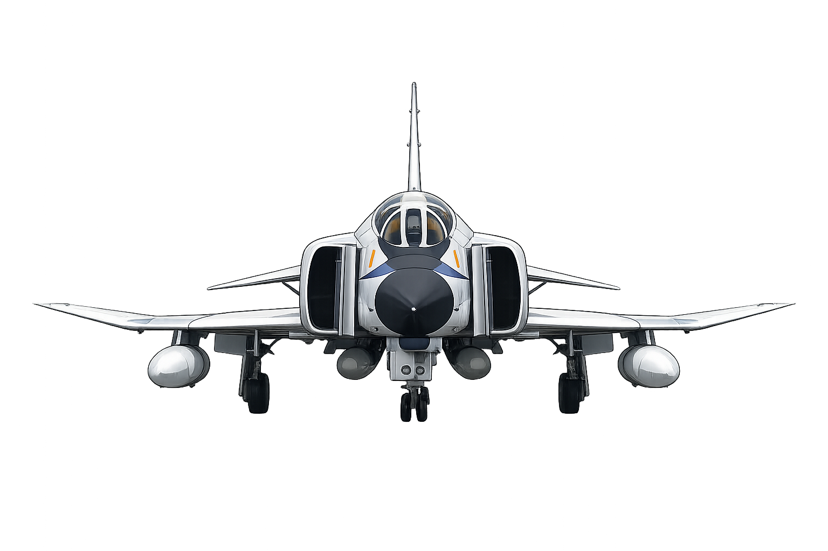
Final Project Robust Flight Control System Design
KOM 501E Control of Systems with
Parametric Uncertainty
Emir Arda Kılıç
0402005--
İsmet Erdoğan
040200522
Notes:
Cover

Slide 2
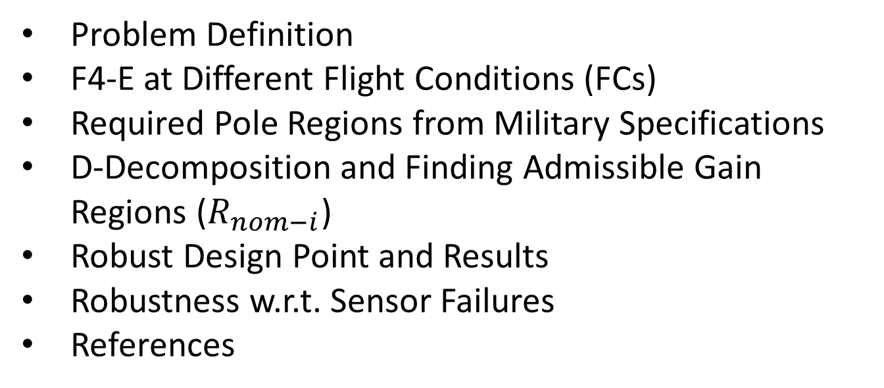
Contents
Problem Definition
F4-E at Different Flight Conditions (FCs)
Required Pole Regions from Military Specifications
D-Decomposition and Finding Admissible Gain Regions ($R_{nom−i}$)
Robust Design Point and Results
Robustness w.r.t. Sensor Failures
References
Notes:
Contents

Slide 3
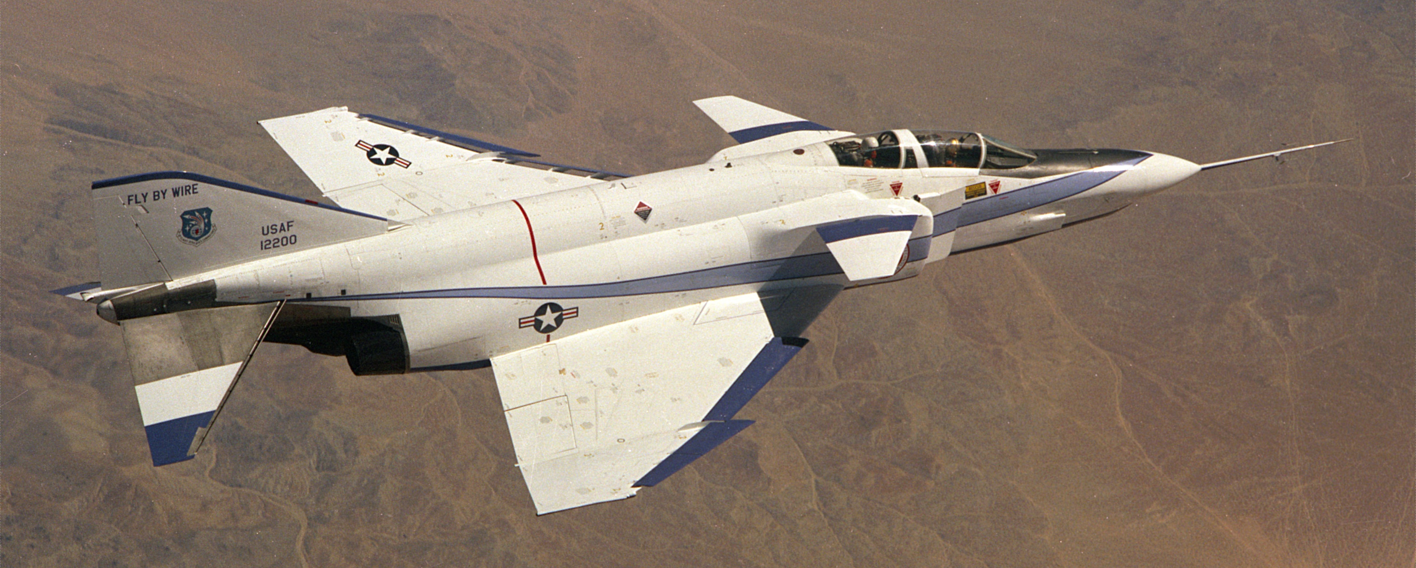
Problem Definition
The short period longitudinal mode of an F4-E aircraft with additional horizontal canards is
unstable in subsonic flight
insufficiently damped and supersonic flight
Horizontal canards destabilizes the aircraft
Design (fixed gain) controller that provide acceptable pole locations according to military specifications for flying qualities in four typical flight conditions simultaneously.
YF-4E: First Fighter Aircraft with Analog Fly-by-Wire
Notes:
Problem Definition (1)

Slide 4
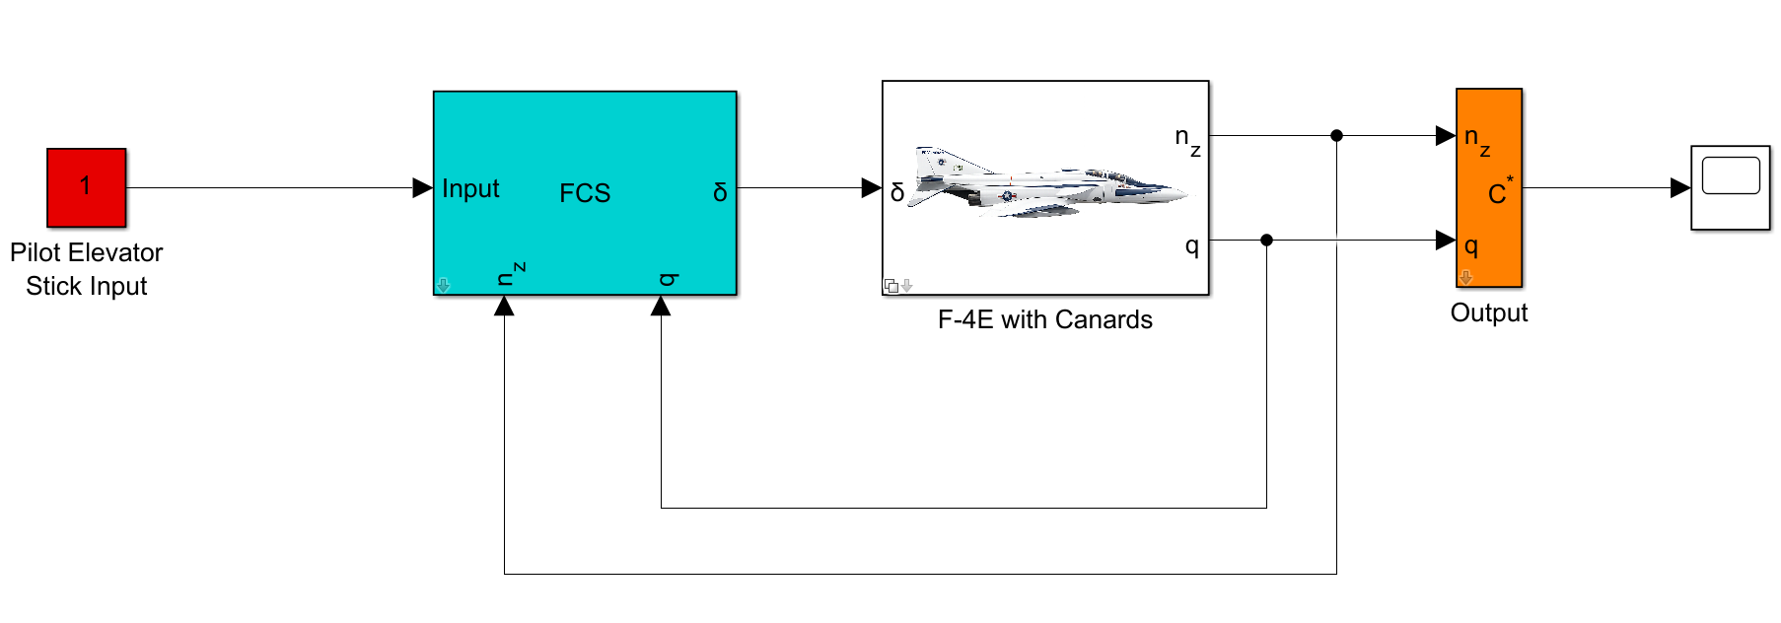
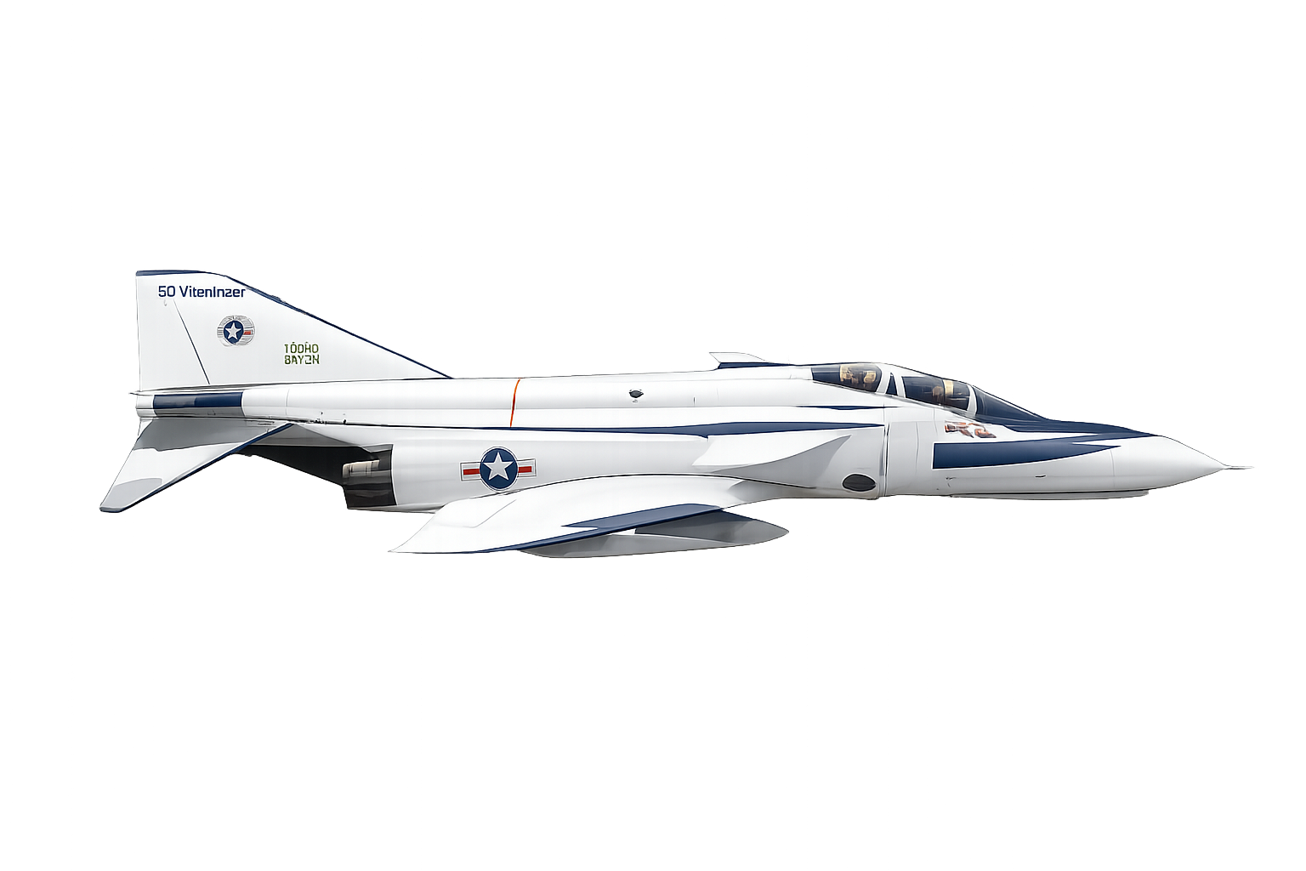

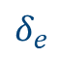
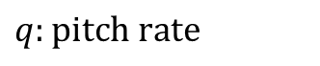

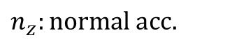
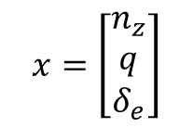
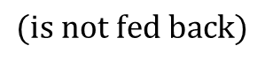
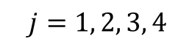
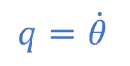
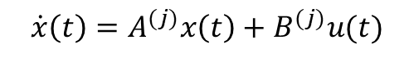
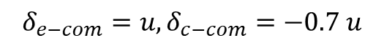

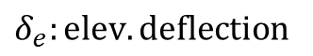
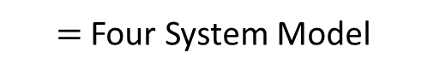

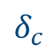
Problem Definition (continued)
Fixed-Gain Controller
Four Flight Condition
Basically state feedback controller
as a flight control system (FCS)
$=$ Four System Model
$$q=\dot{θ}$$
$$\dot{x}\left(t\right)=A^{(j)}x\left(t\right)+B^{(j)}u(t)$$
$$j=1, 2, 3, 4$$
$$V$$
$$θ$$
$$α$$
$$δ_{c}$$
$$δ_{e}$$
$$x=\left[\begin{matrix}n_{z} \\ q \\ δ_{e}\end{matrix}\right]$$
$$n_{z}:normal acc.$$
$$δ_{e−com}=u, δ_{c−com}=−0.7 u$$
$$q:pitch rate$$
$$n_{z}$$
$$δ_{e}:elev. deflection$$
Single Input Problem
$$(is not fed back)$$
Notes:
Problem Definition (2)

Slide 5
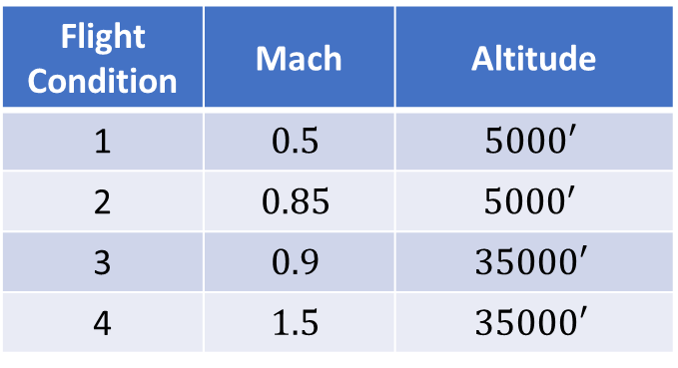
F4-E at Different Flight Conditions
Flight Condition | Mach | Altitude
1 | $$0.5$$ | $$5000′$$
2 | $$0.85$$ | $${5000}^{′}$$
3 | $$0.9$$ | $$35000′$$
4 | $$1.5$$ | $$35000′$$
Actuator Pole
Notes:
F4-E at Different Flight Conditions

Slide 6
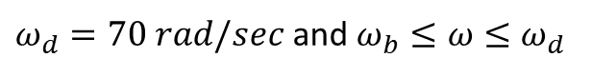
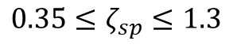
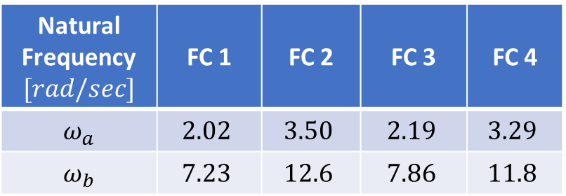
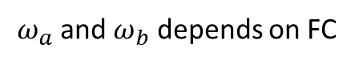
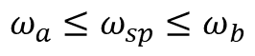
Required Pole Regions from Military Specs.
According to military specifications (MIL-F-8785 C) for flying qualities of piloted airplanes
$$Short Period Mode: \boxed{s^{2}+2ζ_{sp}ω_{sp}+ω_{sp}=0}$$
Restricted Ranges
Natural Frequency $[rad/sec]$ | FC 1 | FC 2 | FC 3 | FC 4
$ω_{a}$ | $$2.02$$ | $$3.50$$ | $$2.19$$ | $$3.29$$
$ω_{b}$ | $$7.23$$ | $$12.6$$ | $$7.86$$ | $$11.8$$
$$0.35≤ζ_{sp}≤1.3$$
$ω_{a}$ and $ω_{b}$ depends on FC
$$ω_{a}≤ω_{sp}≤ω_{b}$$
There are no requirements for the location of additional poles from actuator or feedback dynamics. Quick response is essential for fighter. However, triggering the structural mode frequency should be avoided.
$ω_{d}=70 rad/sec$ and $ω_{b}≤ω≤ω_{d}$
Notes:
Required Pole Regions from Military Specs.

Slide 7
Required Pole Regions from Military Specs. (ctd.)
Notes:
Required Pole Regions from Military Specs. (2)

Slide 8
D-Composition
Notes:
Required Pole Regions from Military Specs. (2)

Slide 9
….
Notes:
Required Pole Regions from Military Specs. (2)

